Slide 1





Application of Column Generation and Branch and Price for Operating Room Planning
Chengbin CHU
Chair Professor of Supply Chain Management
CentraleSupélec
chengbin.chu@ecp.fr

Slide 2
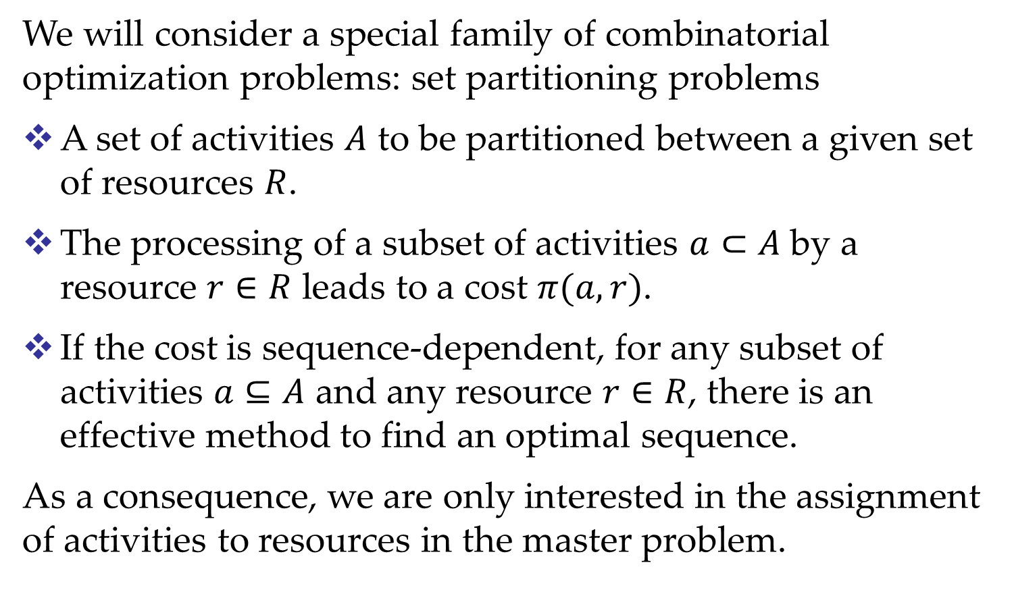
Set partitioning problems
We will consider a special family of combinatorial optimization problems: set partitioning problems
A set of activities $A$ to be partitioned between a given set of resources $R$.
The processing of a subset of activities $a⊂A$ by a resource $r∈R$ leads to a cost $π(a,r)$.
If the cost is sequence-dependent, for any subset of activities $a⊆A$ and any resource $r∈R$, there is an effective method to find an optimal sequence.
As a consequence, we are only interested in the assignment of activities to resources in the master problem.

Slide 3
Examples of applications
Application | Resources | Activities
Crew scheduling | Crews | flights
VRP | Vehicles, drivers | trips
PM Scheduling | machines | jobs
Healthcare | time slots | surgical cases
Bin packing | bins | items

Slide 4
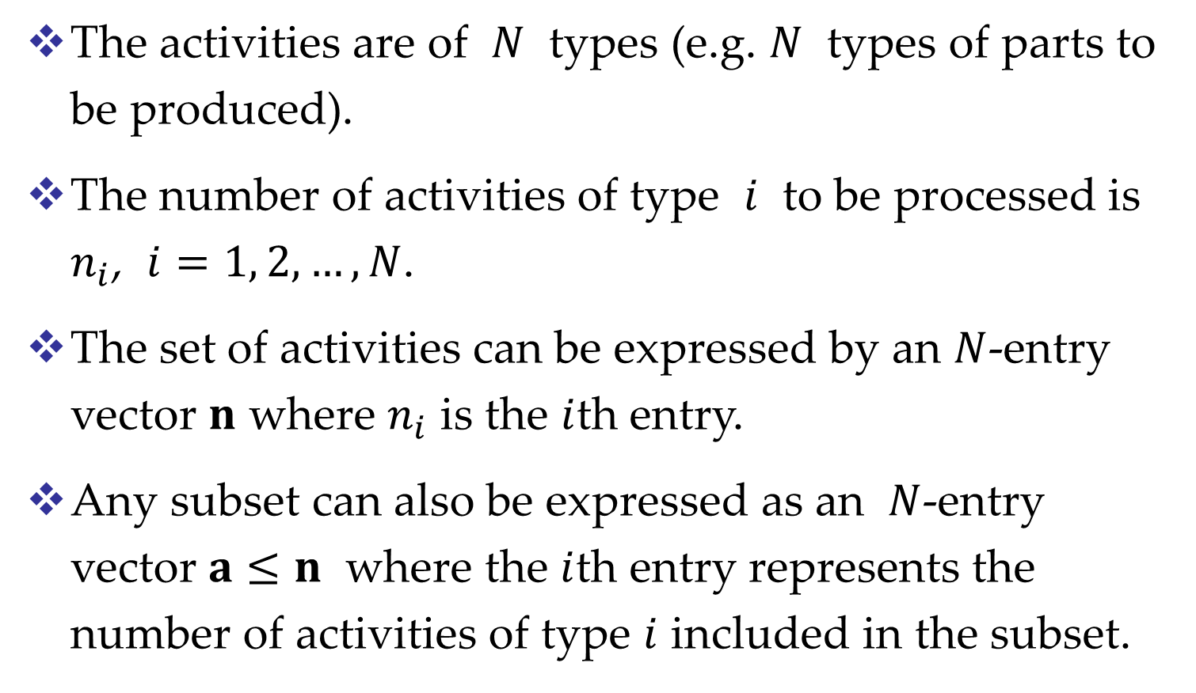
Notation
The activities are of $N$ types (e.g. $N$ types of parts to be produced).
The number of activities of type $i$ to be processed is $n_{i}$, $i=1, 2,…,N$.
The set of activities can be expressed by an $N$-entry vector $n$ where $n_{i}$ is the $i$th entry.
Any subset can also be expressed as an $N$-entry vector $a≤n$ where the $i$th entry represents the number of activities of type $i$ included in the subset.

Slide 5
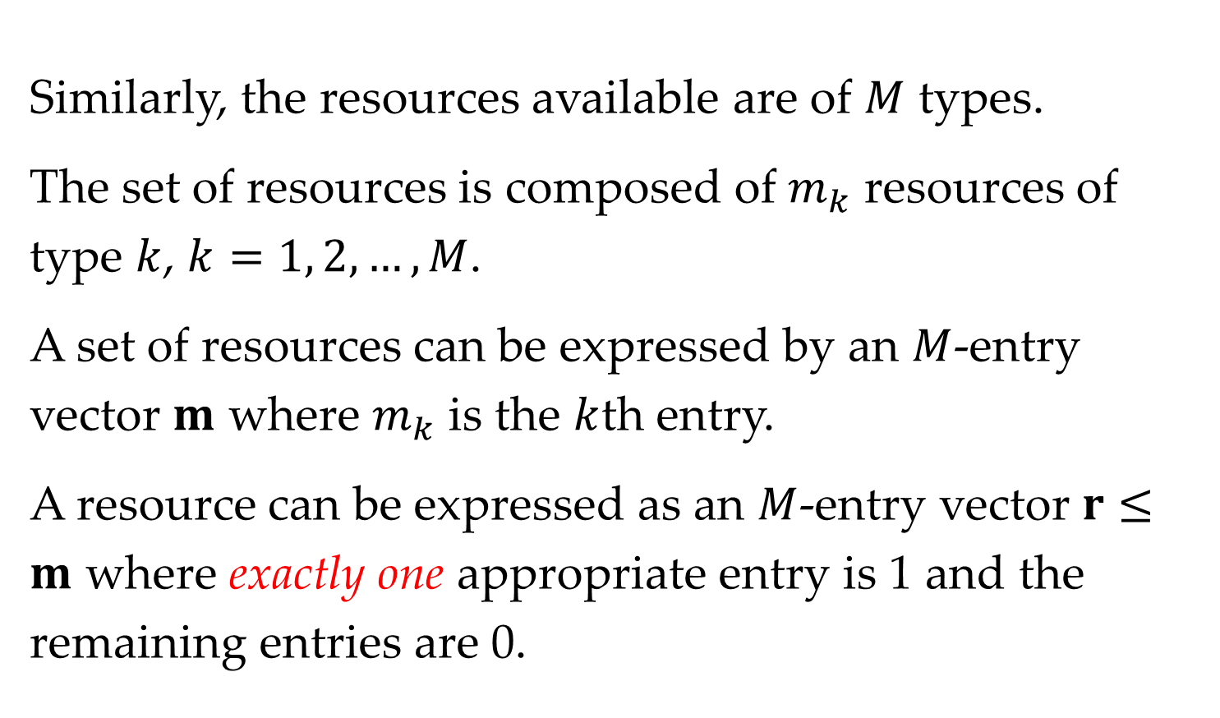
Similarly, the resources available are of $M$ types.
The set of resources is composed of $m_{k}$ resources of type $k$, $k=1, 2,…,M$.
A set of resources can be expressed by an $M$-entry vector $m$ where $m_{k}$ is the $k$th entry.
A resource can be expressed as an $M$-entry vector $r≤m$ where exactly one appropriate entry is 1 and the remaining entries are 0.

Slide 6
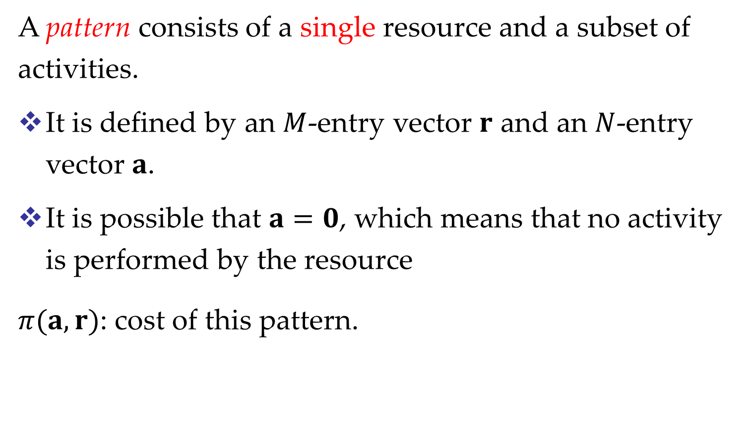
A pattern consists of a single resource and a subset of activities.
It is defined by an $M$-entry vector $r$ and an $N$-entry vector $a$.
It is possible that $a=0$, which means that no activity is performed by the resource
$π(a,r)$: cost of this pattern.

Slide 7
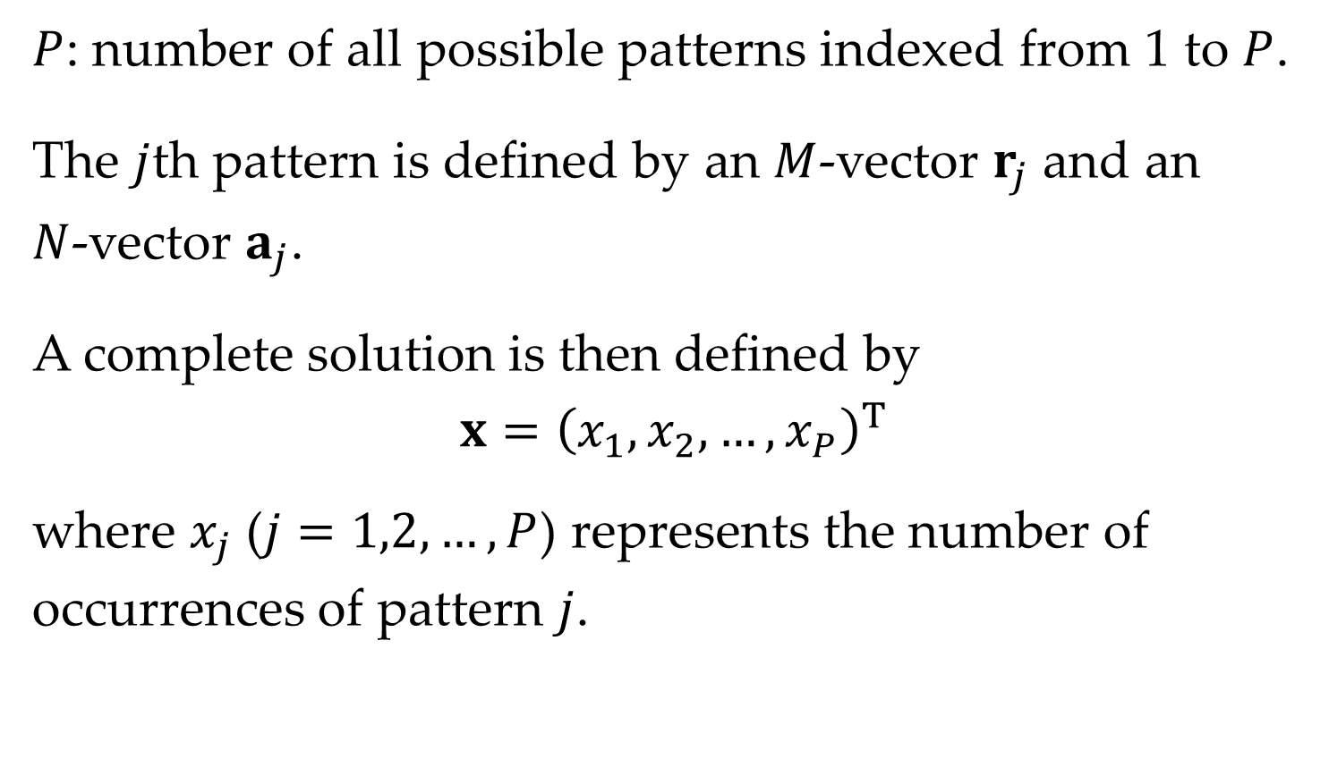
$P$: number of all possible patterns indexed from 1 to $P$.
The $j$th pattern is defined by an $M$-vector $r_{j}$ and an $N$‑vector $a_{j}$.
A complete solution is then defined by
$$x={\left(x_{1},x_{2},…,x_{P}\right)}^{T}$$
where $x_{j}$ ($j=1,2,…,P$) represents the number of occurrences of pattern $j$.

Slide 8

Mathematical model
The problem at hand can be modeled as
$$Minimize \sum_{j=1}^{P}{π\left(a_{j},r_{j}\right)x_{j}}$$
subject to
$$\sum_{j=1}^{P}{a_{j}x_{j}=n}$$
$$\sum_{j=1}^{P}{r_{j}x_{j}= m}$$
$$x∈𝒩^{P}$$

Slide 9
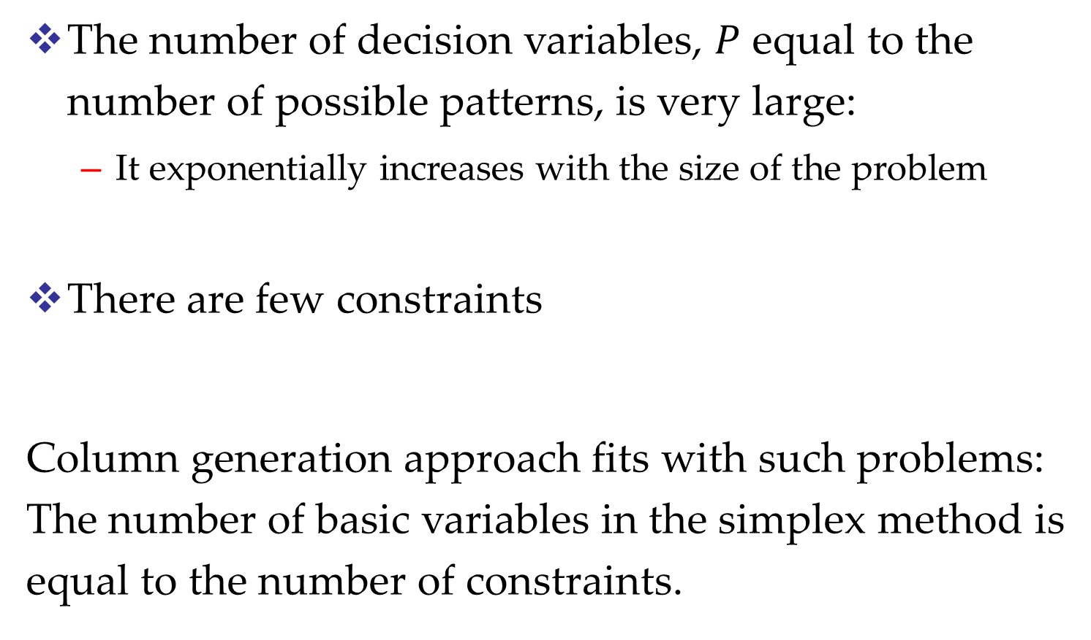
Characteristics
The number of decision variables, $P$ equal to the number of possible patterns, is very large:
  It exponentially increases with the size of the problem
There are few constraints
Column generation approach fits with such problems: The number of basic variables in the simplex method is equal to the number of constraints.

Slide 10
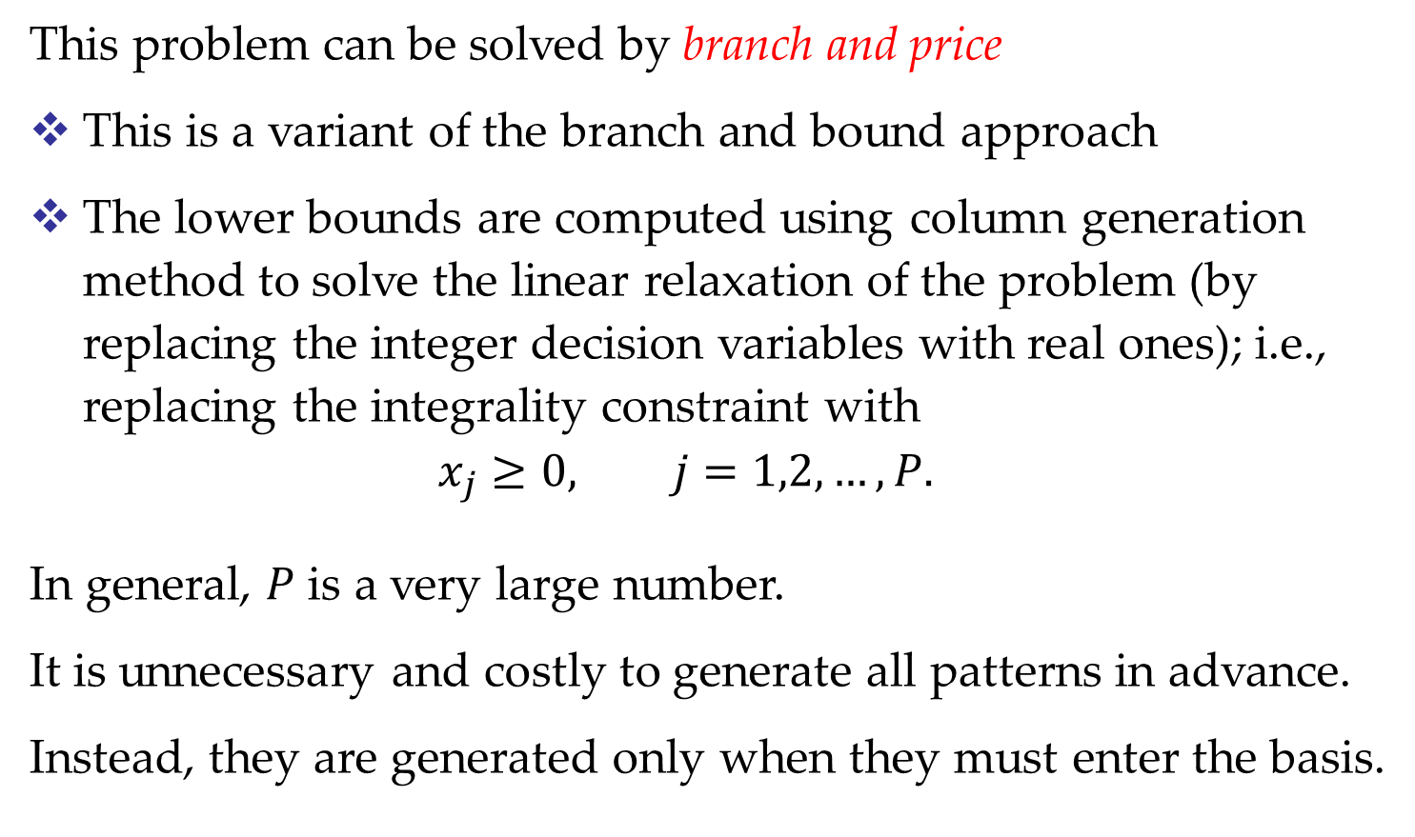
Branch and price
This problem can be solved by branch and price
This is a variant of the branch and bound approach
The lower bounds are computed using column generation method to solve the linear relaxation of the problem (by replacing the integer decision variables with real ones); i.e., replacing the integrality constraint with
$x_{j}≥0, j=1,2,…, P.$
In general, $P$ is a very large number.
It is unnecessary and costly to generate all patterns in advance.
Instead, they are generated only when they must enter the basis.

Slide 11
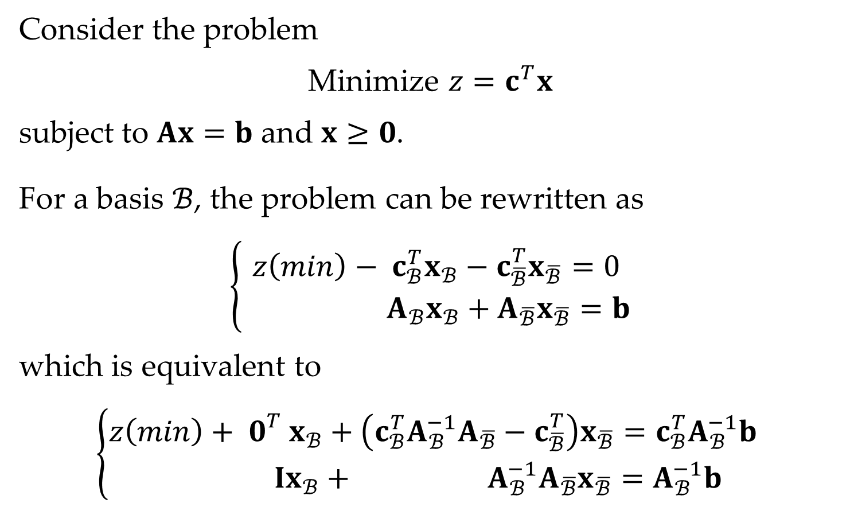
Review of simplex method
Consider the problem
Minimize $z=c^{T}x$
subject to $Ax=b$ and $x≥0$.
For a basis $ℬ$, the problem can be rewritten as
$$\left\{\begin{matrix}z\left(min\right)− c_{ℬ}^{T}x_{ℬ}−c_{\overline{ℬ}}^{T}x_{\overline{ℬ}}=0 \\ { A}_{ℬ}x_{ℬ}+A_{\overline{ℬ}}x_{\overline{ℬ}}=b\end{matrix}\right.$$
which is equivalent to
$$\left\{\begin{matrix}z\left(min\right)+ 0_{}^{T}x_{ℬ}+\left(c_{ℬ}^{T}A_{ℬ}^{−1}A_{\overline{ℬ}}−c_{\overline{ℬ}}^{T}\right)x_{\overline{ℬ}}={c_{ℬ}^{T}A}_{ℬ}^{−1}b \\ Ix_{ℬ}+ {A_{ℬ}^{−1}A}_{\overline{ℬ}}x_{\overline{ℬ}}=A_{ℬ}^{−1}b\end{matrix}\right.$$

Slide 12
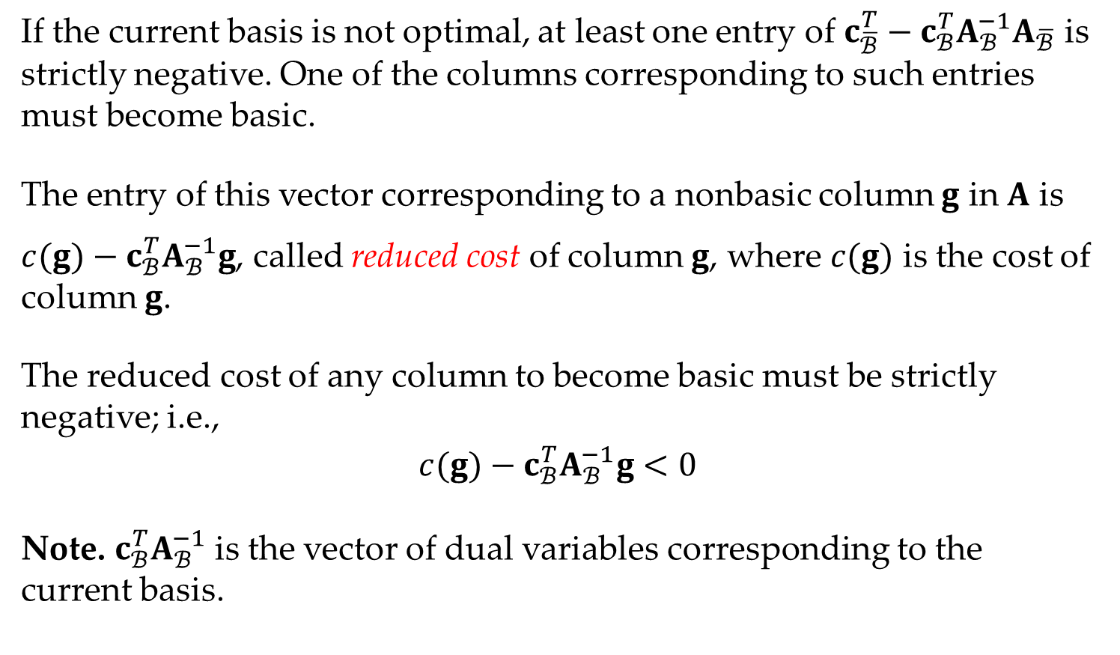
If the current basis is not optimal, at least one entry of ${c_{\overline{ℬ}}^{T}−c}_{ℬ}^{T}A_{ℬ}^{−1}A_{\overline{ℬ}}$ is strictly negative. One of the columns corresponding to such entries must become basic.
The entry of this vector corresponding to a nonbasic column $g$ in $A$ is
${c(g)−c}_{ℬ}^{T}A_{ℬ}^{−1}g$, called reduced cost of column $g$, where $c(g)$ is the cost of column $g$.
The reduced cost of any column to become basic must be strictly negative; i.e.,
$$c(g)−c_{ℬ}^{T}A_{ℬ}^{−1}g<0$$
Note. $c_{ℬ}^{T}A_{ℬ}^{−1}$ is the vector of dual variables corresponding to the current basis.

Slide 13
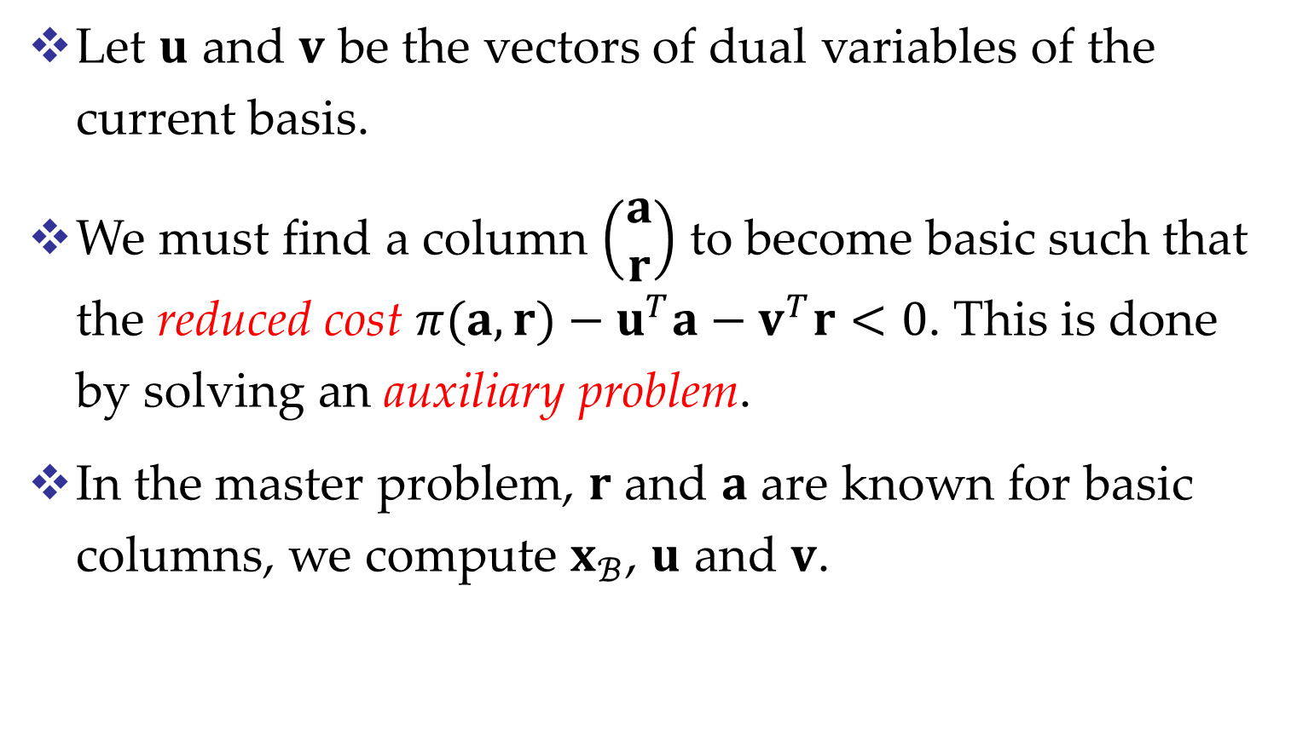
Application of CG to the SPP
Let $u$ and $v$ be the vectors of dual variables of the current basis.
We must find a column $\left(\begin{matrix}a \\ r\end{matrix}\right)$ to become basic such that the reduced cost $π(a,r)−u^{T}a−v^{T}r<0$. This is done by solving an auxiliary problem.
In the master problem, $r$ and $a$ are known for basic columns, we compute $x_{ℬ}$, $u$ and $v$.

Slide 14
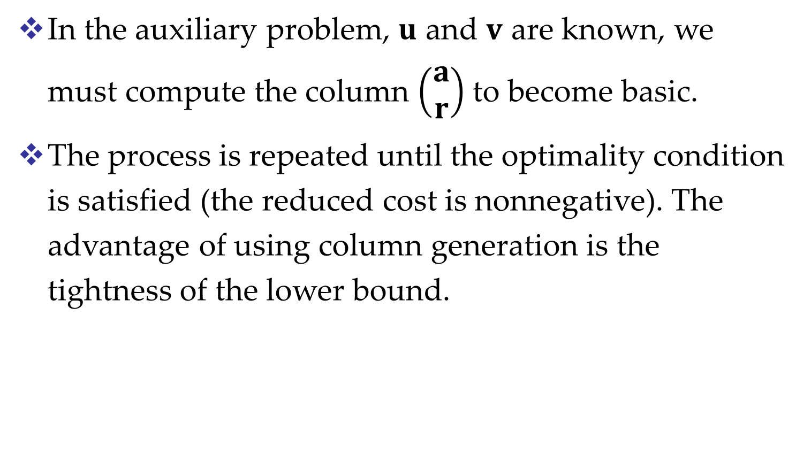
In the auxiliary problem, $u$ and $v$ are known, we must compute the column $\left(\begin{matrix}a \\ r\end{matrix}\right)$ to become basic.
The process is repeated until the optimality condition is satisfied (the reduced cost is nonnegative). The advantage of using column generation is the tightness of the lower bound.

Slide 15
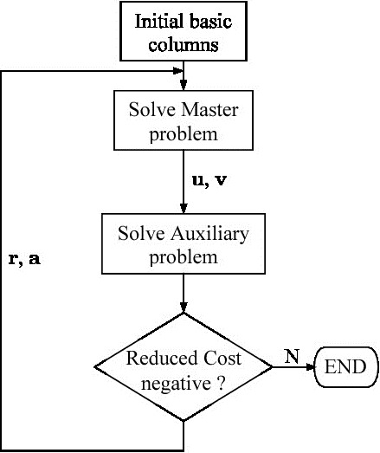
Process of CG

Slide 16
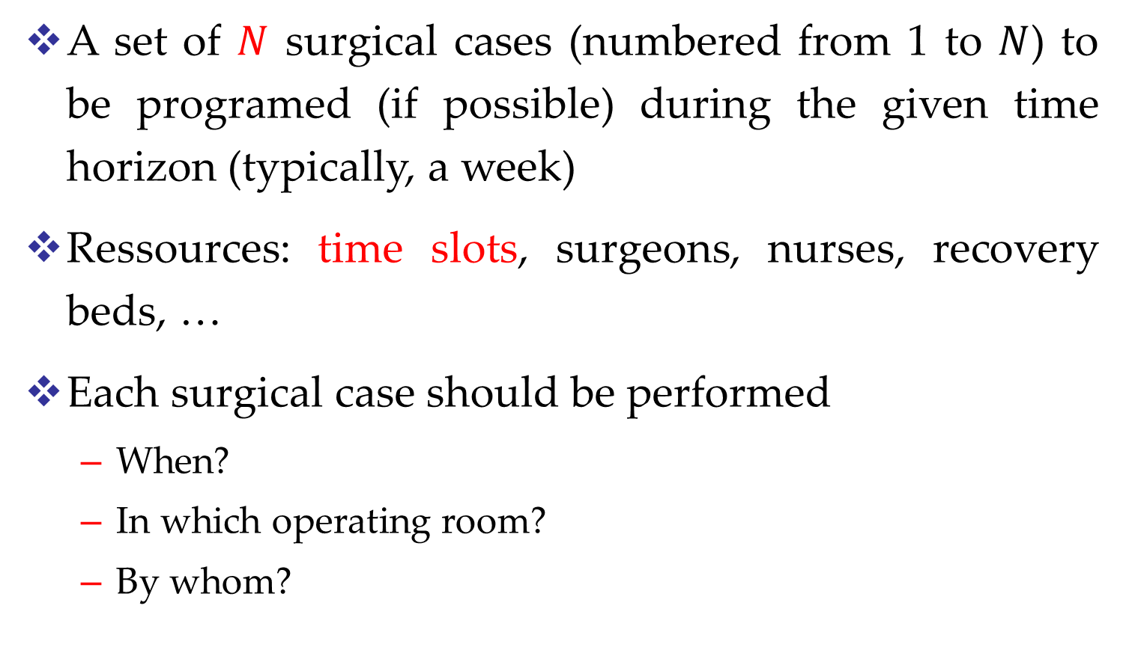
A set of $N$ surgical cases (numbered from 1 to $N$) to be programed (if possible) during the given time horizon (typically, a week)
Ressources: time slots, surgeons, nurses, recovery beds, …
Each surgical case should be performed
  When?
  In which operating room?
  By whom?

Slide 18
Two strategies
Block scheduling: time slots are pre-assigned to surgeons, the remaining problem is to schedule the surgical cases he has to perform
Open scheduling: any time-slot can be used by any surgeons
From planning point of view, the problem is the same for both strategies.

Slide 19
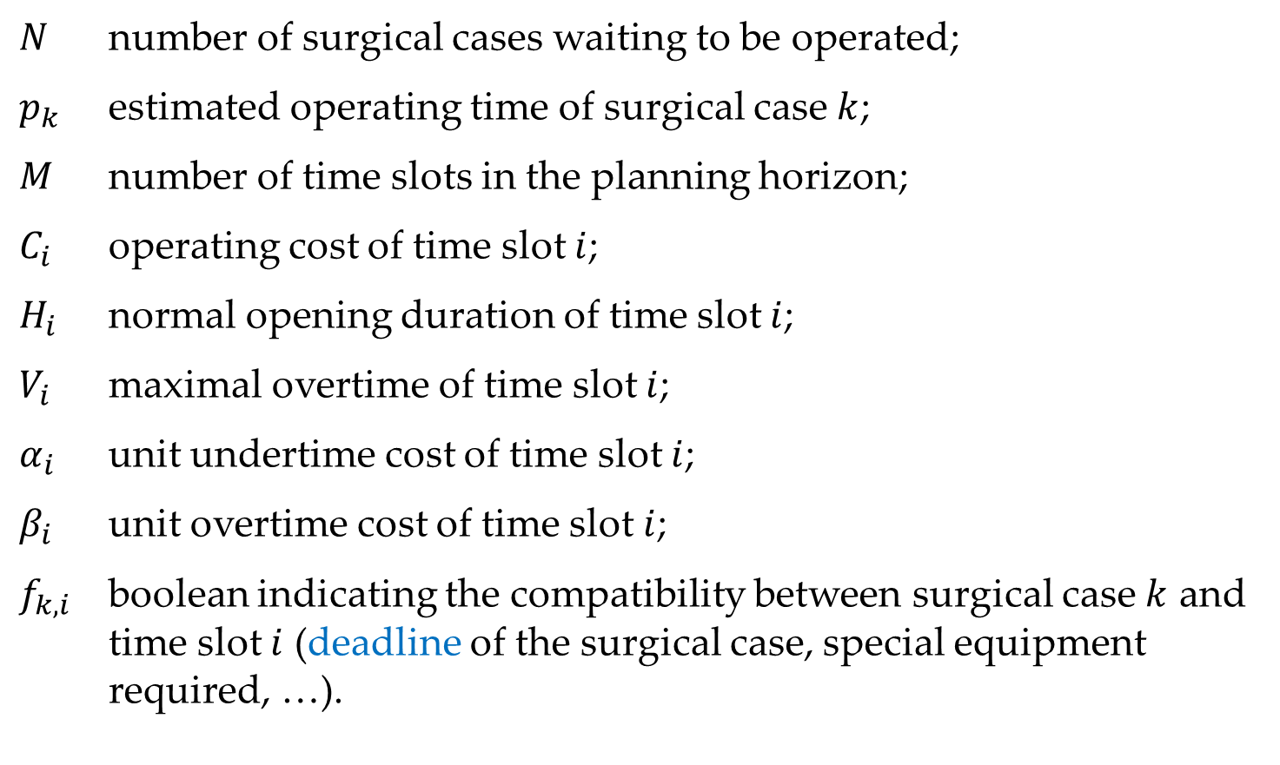
Operating room scheduling
$N$ number of surgical cases waiting to be operated;
$p_{k}$ estimated operating time of surgical case $k$;
$M$ number of time slots in the planning horizon;
$C_{i}$ operating cost of time slot $i$;
$H_{i}$ normal opening duration of time slot $i$;
$V_{i}$ maximal overtime of time slot $i$;
$α_{i}$ unit undertime cost of time slot $i$;
$β_{i}$ unit overtime cost of time slot $i$;
$f_{k,i}$ boolean indicating the compatibility between surgical case $k$ and time slot $i$ (deadline of the surgical case, special equipment required, …).

Slide 20
Notes
There is a dummy time slot with unlimited capacity and with no cost.
All the surgical cases with a deadline beyond the planning horizon are compatible with this dummy time slot;
All the surgical cases which are not actually planned in the planning horizon are considered to be put into this dummy time slot.

Slide 21
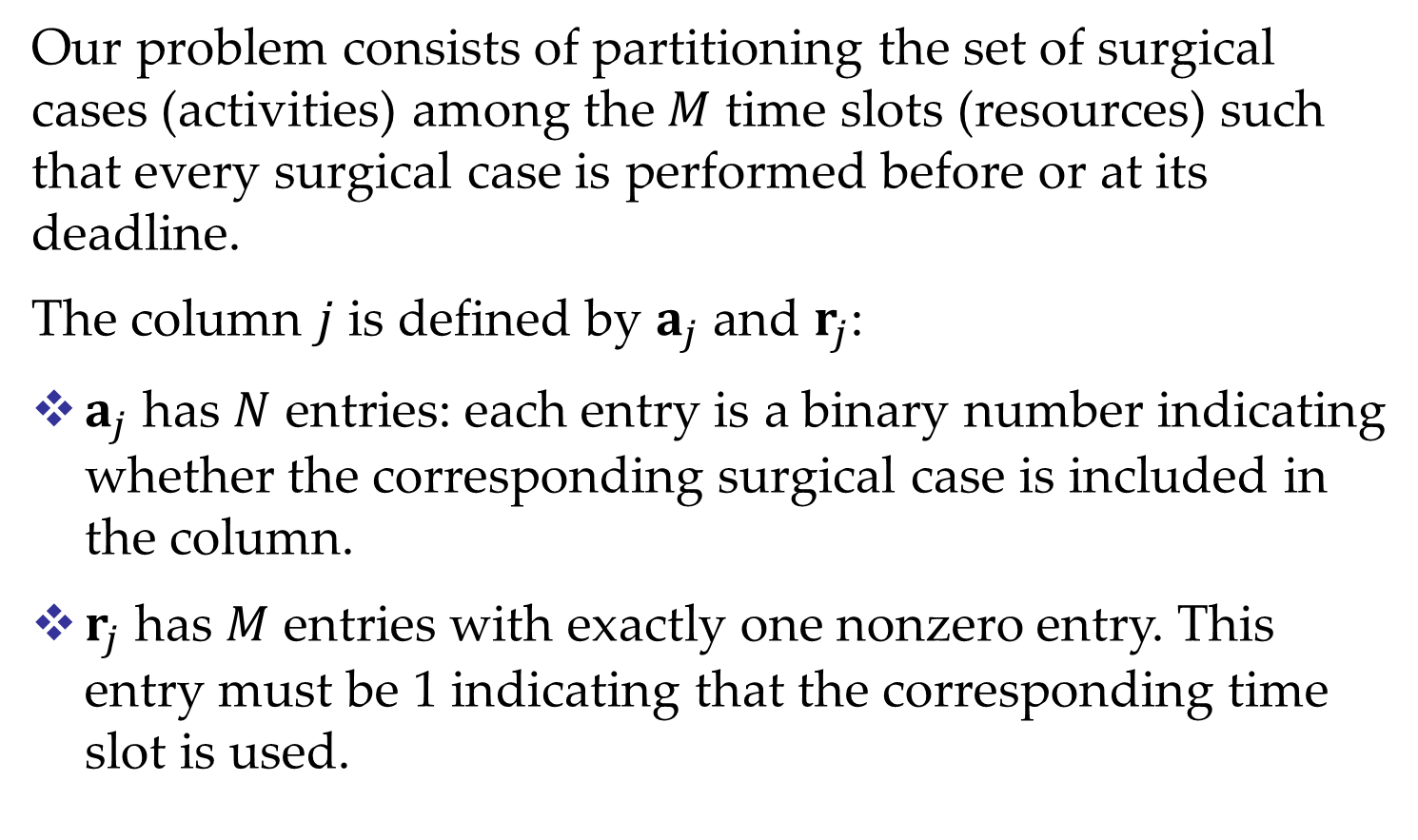
Our problem consists of partitioning the set of surgical cases (activities) among the $M$ time slots (resources) such that every surgical case is performed before or at its deadline.
The column $j$ is defined by $a_{j}$ and $r_{j}$:
$a_{j}$ has $N$ entries: each entry is a binary number indicating whether the corresponding surgical case is included in the column.
$r_{j}$ has $M$ entries with exactly one nonzero entry. This entry must be 1 indicating that the corresponding time slot is used.

Slide 22

Example of a column
Time slot 2
is used to perform
surgical cases 1, 3, 6 and 7.
$$\left[\begin{matrix}\begin{matrix}1 \\ 0 \\ 1\end{matrix} \\ \begin{matrix}0 \\ 0 \\ 1\end{matrix} \\ \begin{matrix}1 \\ 0 \\ \begin{matrix}0 \\ 1 \\ 0\end{matrix}\end{matrix}\end{matrix}\right]$$

Slide 23

Master problem
$$\text{Minimize}\sum_{j=1}^{P}{π\left(a_{j},r_{j}\right)x_{j}}$$
subject to
$$\sum_{j=1}^{P}{a_{j,k}x_{j}}=1, k=1,…,N$$
$$\sum_{j=1}^{P}{r_{j,i}x_{j}}=1, i=1,…,M$$
$$x_{j}≥0, j=1,…,P$$
where $a_{j,k}$ is the $k$th entry of $a_{j}$, $r_{j,i}$ is the $i$th entry of $r_{j}$.

Slide 24

Auxiliary problem
Knowing $u$ and $v$, look for vectors $a$ and $r$ such that
$$π\left(a,r\right)−\sum_{k=1}^{N}{u_{k}a_{k}}−\sum_{i=1}^{M}{v_{i}r_{i}}<0$$
where
$$π(a,r) = \sum_{i=1}^{M}{\left[C_{i}+\max\left(−α_{i}ω_{i},β_{i}ω_{i}\right)\right]}r_{i}$$
provided that
$$ω_{i}≤ V_{i}$$
with
$$ω_{i}=\sum_{k=1}^{N}{p_{k}a_{k}}−H_{i}$$
representing the overtime of the time slot $i$.

Slide 25
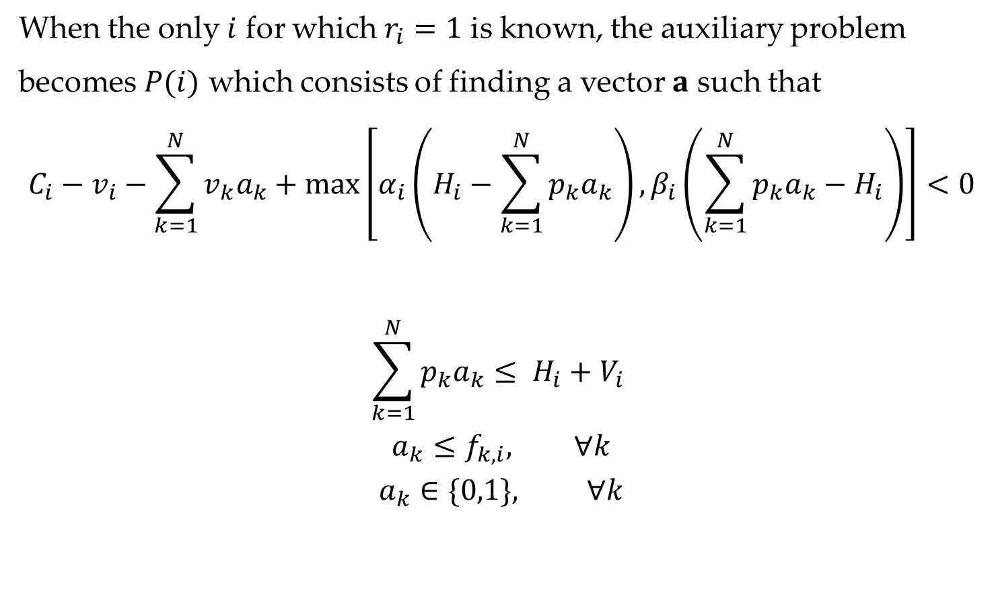
Solving the auxiliary problem
When the only $i$ for which $r_{i}=1$ is known, the auxiliary problem
becomes $P(i)$ which consists of finding a vector $a$ such that
$$C_{i}−v_{i}−\sum_{k=1}^{N}{v_{k}a_{k}}+max\left[α_{i}\left(H_{i}−\sum_{k=1}^{N}{p_{k}a_{k}}\right),β_{i}\left(\sum_{k=1}^{N}{p_{k}a_{k}}−H_{i}\right)\right]<0$$
$$\sum_{k=1}^{N}{p_{k}a_{k}}≤ H_{i}+V_{i}$$
$$a_{k}≤f_{k,i}, ∀k$$
$$a_{k}∈\{0,1\}, ∀k$$

Slide 26
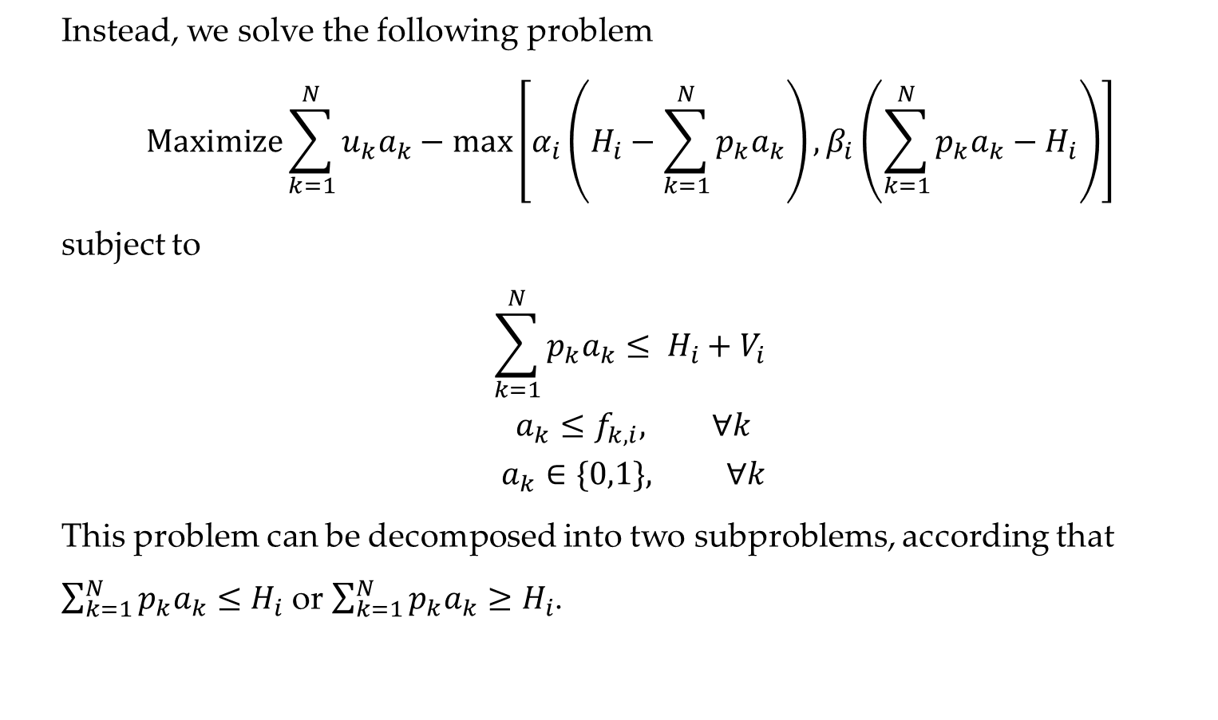
Instead, we solve the following problem
$$\text{Maximize}\sum_{k=1}^{N}{u_{k}a_{k}}−max\left[α_{i}\left(H_{i}−\sum_{k=1}^{N}{p_{k}a_{k}}\right),β_{i}\left(\sum_{k=1}^{N}{p_{k}a_{k}}−H_{i}\right)\right]$$
subject to
$$\sum_{k=1}^{N}{p_{k}a_{k}}≤ H_{i}+V_{i}$$
$$a_{k}≤f_{k,i}, ∀k$$
$$a_{k}∈\{0,1\}, ∀k$$
This problem can be decomposed into two subproblems, according that
$\sum_{k=1}^{N}{p_{k}a_{k}≤H_{i}}$ or $\sum_{k=1}^{N}{p_{k}a_{k}≥H_{i}}$.

Slide 27

First subproblem
$$\text{Maximize}\sum_{k=1}^{N}{{(u}_{k}+α_{i}p_{k})a_{k}}$$
subject to
$$\sum_{k=1}^{N}{p_{k}a_{k}}≤ H_{i}$$
$$a_{k}≤f_{k,i}, ∀k$$
$$a_{k}∈\{0,1\}, ∀k$$

Slide 28

Second subproblem
$$\text{Maximize}\sum_{k=1}^{N}{{(u}_{k}−β_{i}p_{k})a_{k}}$$
subject to
$$H_{i}≤\sum_{k=1}^{N}{p_{k}a_{k}}≤ H_{i}+V_{i}$$
$$a_{k}≤f_{k,i}, ∀k$$
$$a_{k}∈\{0,1\}, ∀k$$

Slide 29
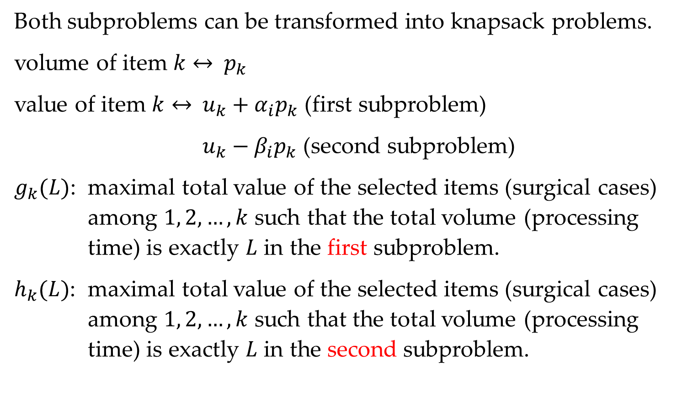
Both subproblems can be transformed into knapsack problems.
volume of item $k$ $↔$ $p_{k}$
value of item $k$ $↔$ $u_{k}+α_{i}p_{k}$ (first subproblem)
$u_{k}−β_{i}p_{k}$ (second subproblem)
$g_{k}(L)$: maximal total value of the selected items (surgical cases) among $1, 2, …, k$ such that the total volume (processing time) is exactly $L$ in the first subproblem.
$h_{k}(L)$: maximal total value of the selected items (surgical cases) among $1, 2, …, k$ such that the total volume (processing time) is exactly $L$ in the second subproblem.

Slide 30
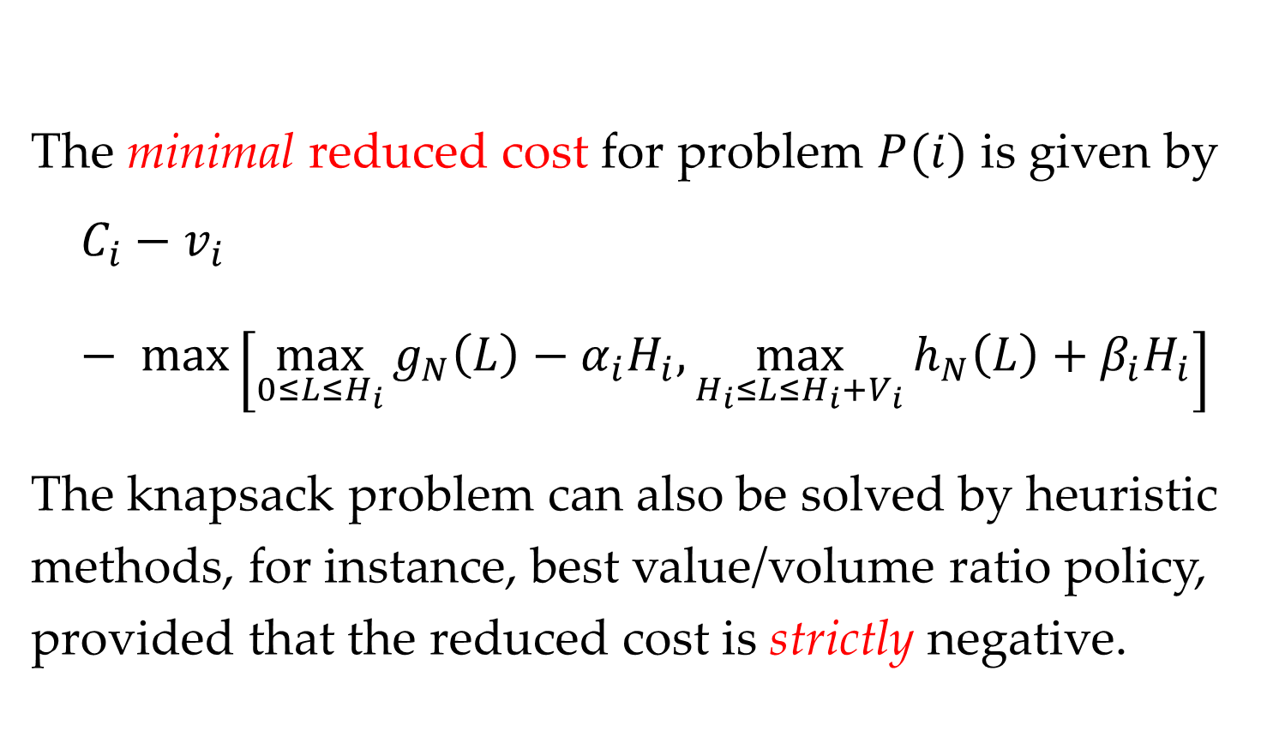
The minimal reduced cost for problem $P(i)$ is given by
$$C_{i}−v_{i}− max\left[\max_{0≤L≤H_{i}}{g_{N}\left(L\right)}−α_{i}H_{i},\max_{H_{i}≤L≤H_{i}+V_{i}}{h_{N}\left(L\right)}+β_{i}H_{i}\right]$$
The knapsack problem can also be solved by heuristic methods, for instance, best value/volume ratio policy, provided that the reduced cost is strictly negative.

Slide 31
Interests of column generation approach
The bound generated by column generation is often very tight, few branchings are needed to find an optimal solution of the unrelaxed problem
Limits and conditions
Time-consuming
Existence of efficient methods to solve the auxiliary problem
Limits on branching strategy: After the branching, the problem must still have the same structure

